Slide 1
STRATEGIES FOR PROTECTING AMOTIA WORKERS AND OWNERS
Meredith Stephens, Esq.
Partner at Rissman Law

Slide 2

Transportation and Infrastructure Asset Management Companies
Works zones among most dangerous places to work
High rates of injuries and fatalities
Work inherently dangerous
Tight labor market
Prevalence of subcontracting

Slide 3

AM Companies
Target for lawsuits
Perceived as having deep pockets
Large insurance policies
Substantial assets
Jury appeal
Do not always make compassionate defendants
Attorneys suing AM companies
Potential for large settlements or jury verdicts

Slide 4
Practical Solution: Employee Training
Increased emphasis on proactive safety measures
Fewer accidents, injuries, fatalities
Less lost time

Slide 5

Work Force Challenges
Competition for qualified workers
Tight labor market
Difficult to hire, employ, retain qualified workers
Qualification and professionalism declined
Less experienced workers being hired and employed
More accidents

Slide 6
Suggestions for Training
Conduct thorough background check on worker
Conduct ongoing training on company safety policies and procedures
Assure company compliance with internal training policies and procedures
Document ongoing training with new hires and existing employees

Slide 7

Training Considerations: Evidence
Big Brother is watching!
Medical, scientific, and electronic information
Electronic logs
On-board computers
Satellite information
Track vehicle and worker movement and position
Messaging
Content of communications between workers

Slide 8


Training Considerations: Evidence
Dispatch records
Credit cards
Cell phone data and usage
Casino player cards!
Drug and alcohol tests
Dash cams
All show worker activities in before, after and during work zone activity
Can and will be used against you!

Slide 9
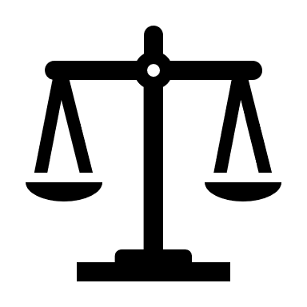

Training Benefits
Juries will consider:
Factors noted above
AM company safety records
AM worker records
Company history and philosophy
Worker supervision and management
Hiring practices
Measures AM company takes to ensure workers operating safely
Each AM company should have designated Safety Officer

Slide 10
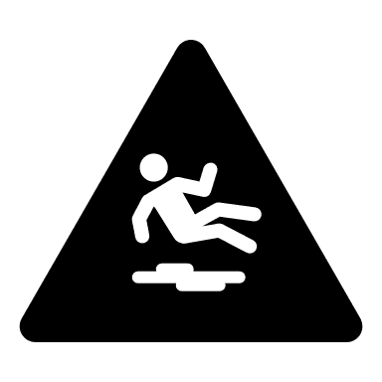
Training Benefits
Outside Courtroom
Better educated employees
Safer work zones
Less accidents
Less injuries/fatalities
Fewer lost time incidents
Higher productivity

Slide 11
Innovator’s Dilemma
How do we implement innovative safety measures?
Historical approach of AM owners, contractors, suppliers, and vendors
Defensive rather than a proactive approach to worker safety
Risk dilemma
Participate in innovative safety measures and assume liability if accident occurs?
Stand back and accept risk of a higher incidence?

Slide 12
Innovator’s Dilemma: Practical Suggestions
Obtain industry feedback to identify problem with specificity
Match innovation with users’ needs
Collaborate with industry members
Understand risks and benefits from industry and legal perspective

Slide 13

Thank You

